Slide 1
Chapter Two
Company and Marketing Strategy
Partnering to Build Customer Relationships

Slide 2
Companywide Strategic Planning
Strategic Planning
Strategic planning is the process of developing and maintaining a strategic fit between the organization’s goals and capabilities and its changing marketing opportunities

Slide 3
Companywide Strategic Planning
Defining a Market-Oriented Mission
The mission statement is the organization’s purpose, what it wants to accomplish in the larger environment
Market-oriented mission statement defines the business in terms of satisfying basic customer needs

Slide 4
Companywide Strategic Planning
Analyzing the Current Business Portfolio
Strategic business unit (SBU) is a unit of the company that has a separate mission and objectives that can be planned separately from other company businesses
Company division
Product line within a division
Single product or brand

Slide 5
Companywide Strategic Planning
Designing the Business Portfolio
The business portfolio is the collection of businesses and products that make up the company
Portfolio analysis is a major activity in strategic planning whereby management evaluates the products and businesses that make up the company

Slide 6
Companywide Strategic Planning
Developing Strategies for Growth
Product/market expansion grid is a tool for identifying company growth opportunities through market penetration, market development, product development, or diversification

Slide 7
Portfolio Growth Strategies
Product/ Market Expansion Grid
1. Market
Penetration
3. Product
Development
Existing
Products
New
Products
Existing
Markets
2. Market
Development
4. Diversification
New
Markets
Notes:
Product/Market Expansion Grid
This CTR corresponds to Figure 2-4 on p. 41 and relates to the material on pp. 41-42.
Developing Growth Strategies
Market Penetration. A penetration strategy involves increasing sales to present target customers. The product itself remains unchanged although there may be a substantial change in how the product is promoted. You may wish to link market penetration with other company-wide strategies such as market leader if appropriate to course progress at this time.
Market Development. A market development strategy involves identifying new segments for the current products offered by the company. Market development can be successful for old products like Arm & Hammer Baking Soda (used as a refrigerator deodorant). You may wish to link market development to emerging technologies such as geodemographics for identifying new market segments.
Product Development. A product development seeks growth by modifying existing products or introducing new products to serve an existing market. Line extensions in snack foods are often useful for illustrating this strategy to students. You may ask your class how many flavors of Doritos they can name as an example.
Diversification. This strategy involves taking profits from existing products or businesses to acquire or enter new markets, usually in different industries from previous company efforts. RJR buying Nabisco is an example.

Slide 8
BCG MATRIX
Relative Market Share
High Low
Stars
High growth & share
Profit potential
May need heavy
investment to grow
  Mobilink
Question Marks
High growth, low share
Build into Stars/ phase out
Requires cash to hold
market share
Telenor
Market Growth Rate
Low High
Cash Cows
Low growth, high share
Established, successful
SBU’s
MTM, interloop
Dogs
Low growth & share
Low profit potential
Small textile units
Notes:
Analyzing Current SBU’s: Boston Consulting Group Approach
This CTR corresponds to Figure 2-2 on p. 39 and relates to the discussion on pp. 38-39.
Designing the Business Portfolio
The business portfolio is the collection of businesses and products that make up the company. In portfolio analysis, management evaluates the businesses for their strategic fit in meeting company objectives. Strategic Business Units (SBUs) consist of separate units of the company that can be planned independently from other company businesses.
The BCG Matrix
Stars. High growth, high share businesses. Stars often require heavy investment to build/maintain share in rapidly expanding markets. You may wish to discuss the importance of market share to product profitability at this point.
Cash Cows. Low growth, high share businesses. Cows generate profits for investment in other businesses.
Question Marks. High growth, low share businesses. Strategy must decide between further investment to move question marks to star status or phasing the product out.
Dogs. Low growth, low share. Dogs are often targets for divestment, but may still be profitable and/or contribute to other organizational goals.

Slide 9
Product/ Market Expansion Grid
Market Penetration: increase sales to present customers with current products. How? Cut prices, increase advertising, get products into more stores.
Market Development: develop new markets with current products. How? Identify new demographic or geographic markets.
Product Development: offering modified or new products to current customers. How? New styles, flavors, colors, or modified products.
Diversification: new products for new markets. How? Start up or buy new businesses.

Slide 10
Managing the Marketing Effort
Marketing Analysis of Company’s Situation
Control
Marketing Planning
Develop Marketing
Strategies to
Achieve Marketing
Objectives
Develop
Marketing
Plans & Budget
Marketing
Implementation
Turn Marketing Plans
into
Action Plans
to Achieve
Marketing
Objectives
Measure
Results
Evaluate
Results
Take
Corrective
Action
Notes:
Managing the Marketing Effort
This CTR corresponds to Figure 2-7 on p. 50 and relates to the material on pp. 50-55.
Managing the Marketing Effort
Analysis. Tools of analysis include marketing research, marketing information systems, demand forecast models, and systematic if more subjective sources of information such as sales force composites and expert judgments. Even while taking advantage of constantly improving technologies, marketers must know when their own judgment must be relied on as well. If there is much science to marketing, there remains a great deal of art to it as well.
Planning. Planning involves deciding on the marketing strategies that will help the company attain its overall objectives. The marketing plan is discussed on the following CTR.
Implementation. Through implementation, the company turns the strategic and marketing plans into actions that will achieve the company’s strategic objectives. You may wish to remind students that planning can become a self-absorbing activity that needs constant re-connection to real world marketing constraints.
Control. Control consists of measuring and evaluating the results of marketing plans and activities and taking corrective actions to make sure objectives are being reached.
Discussion Note: Ask students to discuss how these steps in managing the marketing effort are interdependent and mutually influencing. How example, how does the experience a manager gains from taking corrective actions influence the planning process? Does it in turn affect how analysis is conducted? Resources used for analysis?

Slide 11

Marketing Control & Audit
Set Marketing Goals
Measure
Performance
Evaluate
Performance
Take Corrective
Action
Notes:
Marketing Control
This CTR corresponds to Figure 2-8 on p. 53 and relates to the material on pp. 53-55 .
Marketing Control
Marketing control is the process of measuring and evaluating the results of marketing strategies and plans and taking corrective action to ensure that marketing objectives are attained. Four Steps of Control Include:
Set Goals. It is important that students understand that the control process is proactive in nature. Management starts by deciding which goals it wants to reach. Goals are integrated into all marketing plans and should be reasonable and specific.
Measure Performance. In determining the success of the marketing efforts, performance in the marketplace and the company must be objectively measured. The measurements then become the basis for considering how things are working out for the company.
Evaluate Performance. Many students will bring with them a negative connotation of the evaluation process. You may want to encourage them to think that the evaluation step is a diagnostic one. Few companies use this step or the following one for strictly punishing marketing personnel. Evaluation may identify a need for improvement for the marketers, but it also may indicated changed environmental conditions, new competitive threats, unrealistic goals, or faulty strategic assumptions. Encourage your students to articulate and discuss evaluation as a beneficial professional experience as well as an inevitable necessary part of strategic planning.
Take Corrective Action. Again, many students will see “corrective” as a necessary evil. Invite them to consider that all organizations seek feedback on performance in order to make changes in their competitive behavior. Coaches use half-time and time outs to take corrective action. Marketing managers use the control process to “tinker” with the plans in order to help all members of the marketing team perform well.

Slide 12
Situation Analysis
SWOT Analysis
Strength
Weakness
Opportunities
Threats
Internal
External

Slide 13
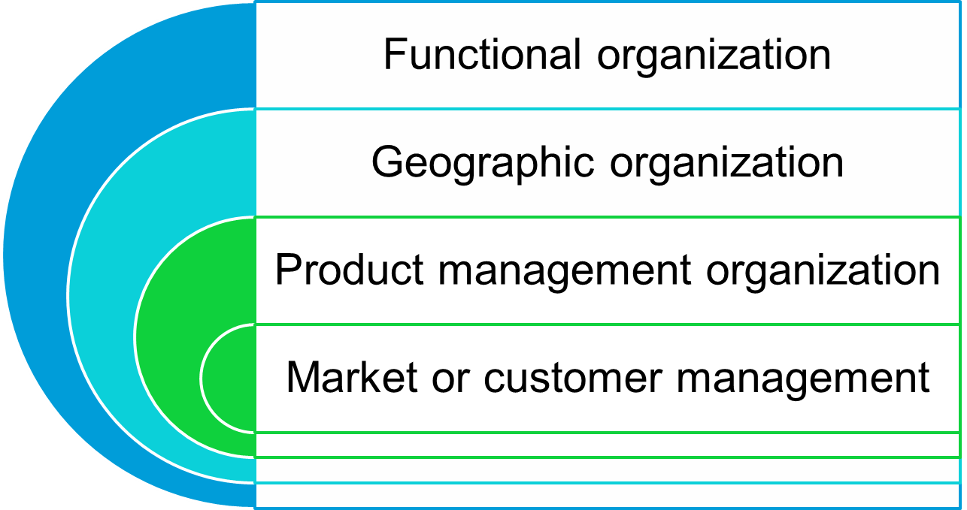
Managing the Marketing Effort
Marketing Department Organization

